Slide 1
COT5615: Math for Intelligent Systems I
Anand Rangarajan
Lecture 17

Slide 2
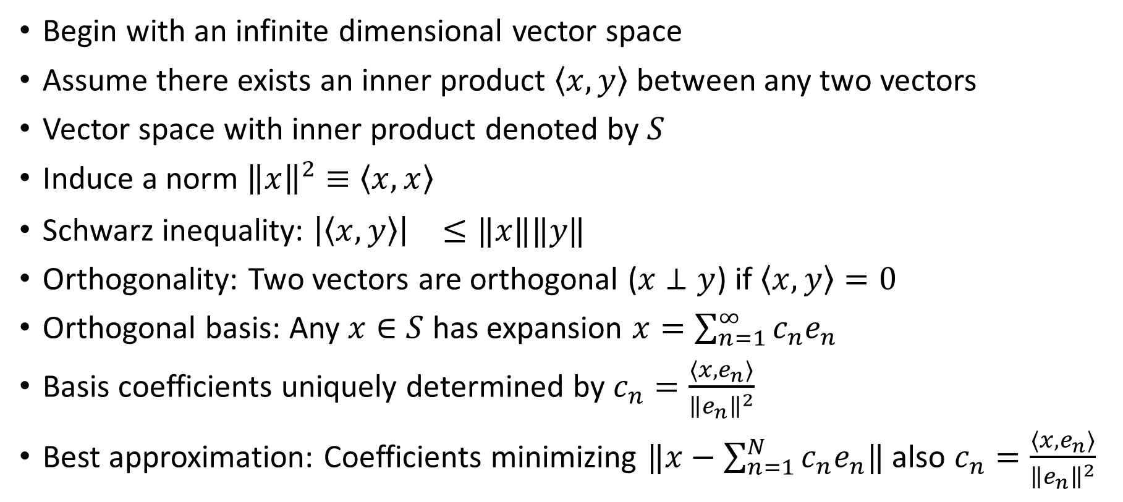
Hilbert Spaces: The Story So Far
Begin with an infinite dimensional vector space
Assume there exists an inner product $\left\langle x,y\right\rangle$ between any two vectors
Vector space with inner product denoted by $S$
Induce a norm ${\left\|x\right\|}^{2}≡\left\langle x,x\right\rangle$
Schwarz inequality: ${\left|\left\langle x,y\right\rangle \right|}^{}≤‖x‖‖y‖$
Orthogonality: Two vectors are orthogonal ($x⊥y$) if $\left\langle x,y\right\rangle =0$
Orthogonal basis: Any $x∈S$ has expansion $x=\sum_{n=1}^{∞}{c_{n}e_{n}}$
Basis coefficients uniquely determined by $c_{n}=\frac{⟨x,e_{n}⟩}{{\left\|e_{n}\right\|}^{2}}$
Best approximation: Coefficients minimizing $‖x−\sum_{n=1}^{N}{c_{n}e_{n}‖}$ also $c_{n}=\frac{⟨x,e_{n}⟩}{{\left\|e_{n}\right\|}^{2}}$

Slide 3
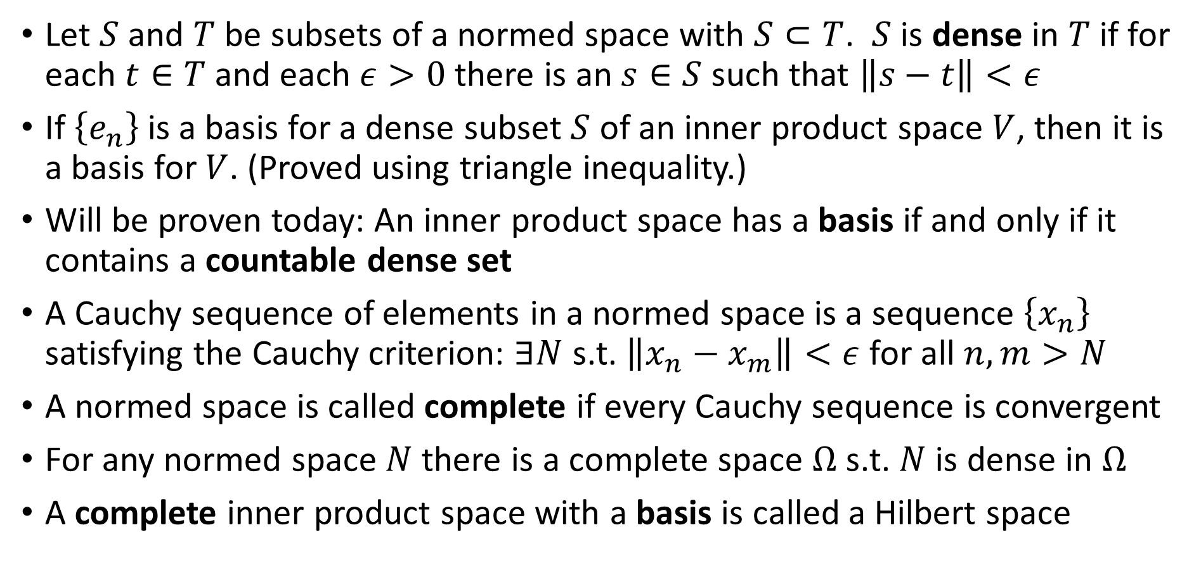
Hilbert Spaces: The Story So Far (contd.)
Let $S$ and $T$ be subsets of a normed space with $S⊂T$. $S$ is dense in $T$ if for each $t∈T$ and each $ε>0$ there is an $s∈S$ such that $\left\|s−t\right\|<ε$
If $\left\{e_{n}\right\}$ is a basis for a dense subset $S$ of an inner product space $V$, then it is a basis for $V$. (Proved using triangle inequality.)
Will be proven today: An inner product space has a basis if and only if it contains a countable dense set
A Cauchy sequence of elements in a normed space is a sequence $\left\{x_{n}\right\}$ satisfying the Cauchy criterion: $∃N$ s.t. $\left\|x_{n}−x_{m}\right\|<ε$ for all $n,m>N$
A normed space is called complete if every Cauchy sequence is convergent
For any normed space $N$ there is a complete space $Ω$ s.t. $N$ is dense in $Ω$
A complete inner product space with a basis is called a Hilbert space

Slide 4
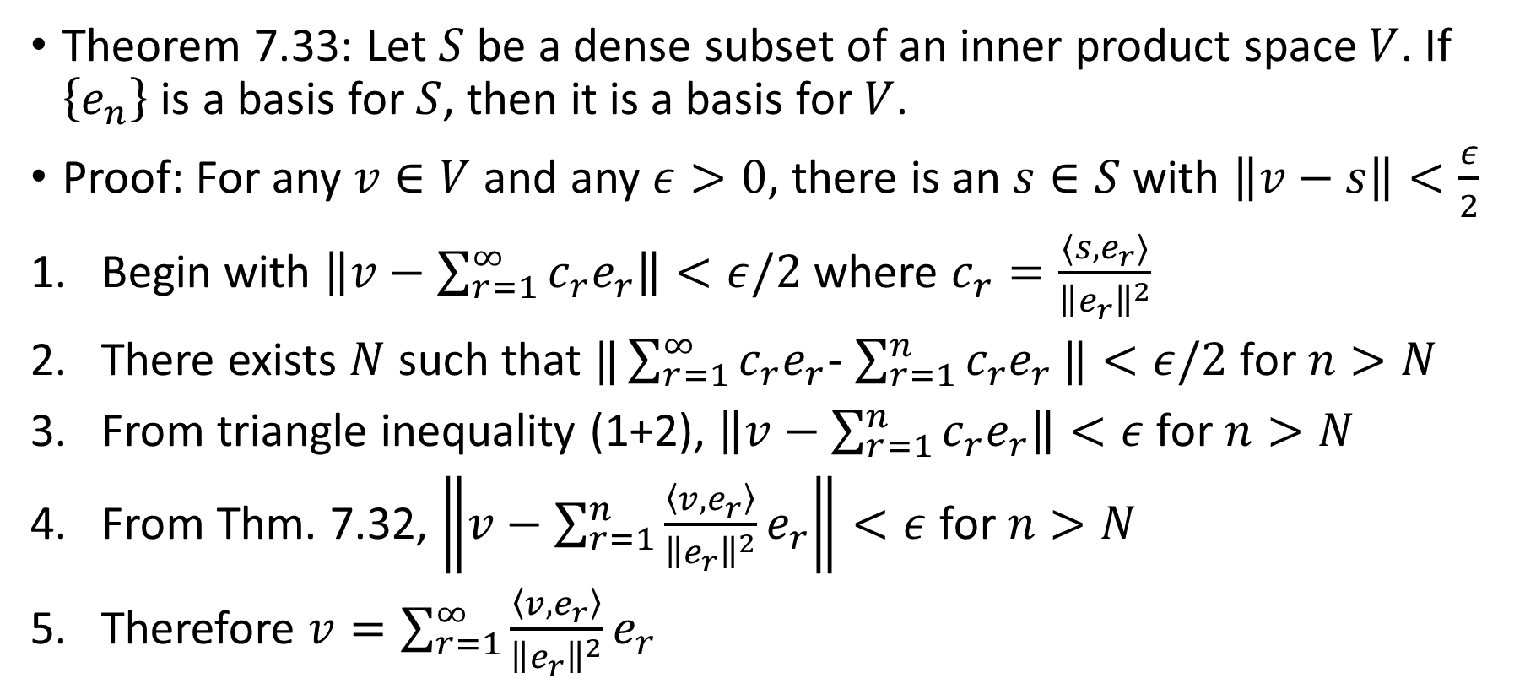
Dense Subsets and Basis
Theorem 7.33: Let $S$ be a dense subset of an inner product space $V$. If $\left\{e_{n}\right\}$ is a basis for $S$, then it is a basis for $V$.
Proof: For any $v∈V$ and any $ε>0$, there is an $s∈S$ with $\left\|v−s\right\|<\frac{ε}{2}$
Begin with $\left\|v−\sum_{r=1}^{∞}{c_{r}e_{r}}\right\|<ε/2$ where $c_{r}=\frac{⟨s,e_{r}⟩}{{\left\|e_{r}\right\|}^{2}}$
There exists $N$ such that $‖\sum_{r=1}^{∞}{c_{r}e_{r}}$- $\sum_{r=1}^{n}{c_{r}e_{r}}‖<ε/2$ for $n>N$
From triangle inequality (1+2), $\left\|v−\sum_{r=1}^{n}{c_{r}e_{r}}\right\|<ε$ for $n>N$
From Thm. 7.32, $\left\|v−\sum_{r=1}^{n}{\frac{\left\langle v,e_{r}\right\rangle }{{\left\|e_{r}\right\|}^{2}}e_{r}}\right\|<ε$ for $n>N$
Therefore $v=\sum_{r=1}^{∞}{\frac{\left\langle v,e_{r}\right\rangle }{{\left\|e_{r}\right\|}^{2}}e_{r}}$

Slide 5
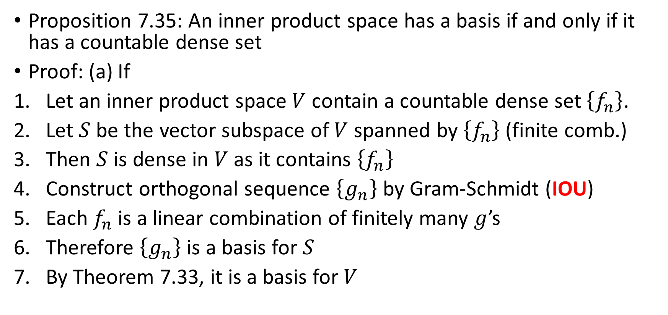
Existence of a Basis
Proposition 7.35: An inner product space has a basis if and only if it has a countable dense set
Proof: (a) If
Let an inner product space $V$ contain a countable dense set $\left\{f_{n}\right\}$.
Let $S$ be the vector subspace of $V$ spanned by $\left\{f_{n}\right\}$ (finite comb.)
Then $S$ is dense in $V$ as it contains $\left\{f_{n}\right\}$
Construct orthogonal sequence $\left\{g_{n}\right\}$ by Gram-Schmidt (IOU)
Each $f_{n}$ is a linear combination of finitely many $g$’s
Therefore $\left\{g_{n}\right\}$ is a basis for $S$
By Theorem 7.33, it is a basis for $V$
Notes:
3rd point -> The reason this is true is that it consists of all the finite linear combination of f's, and so s will contain all the f's from f1 to f infinity.

Slide 6
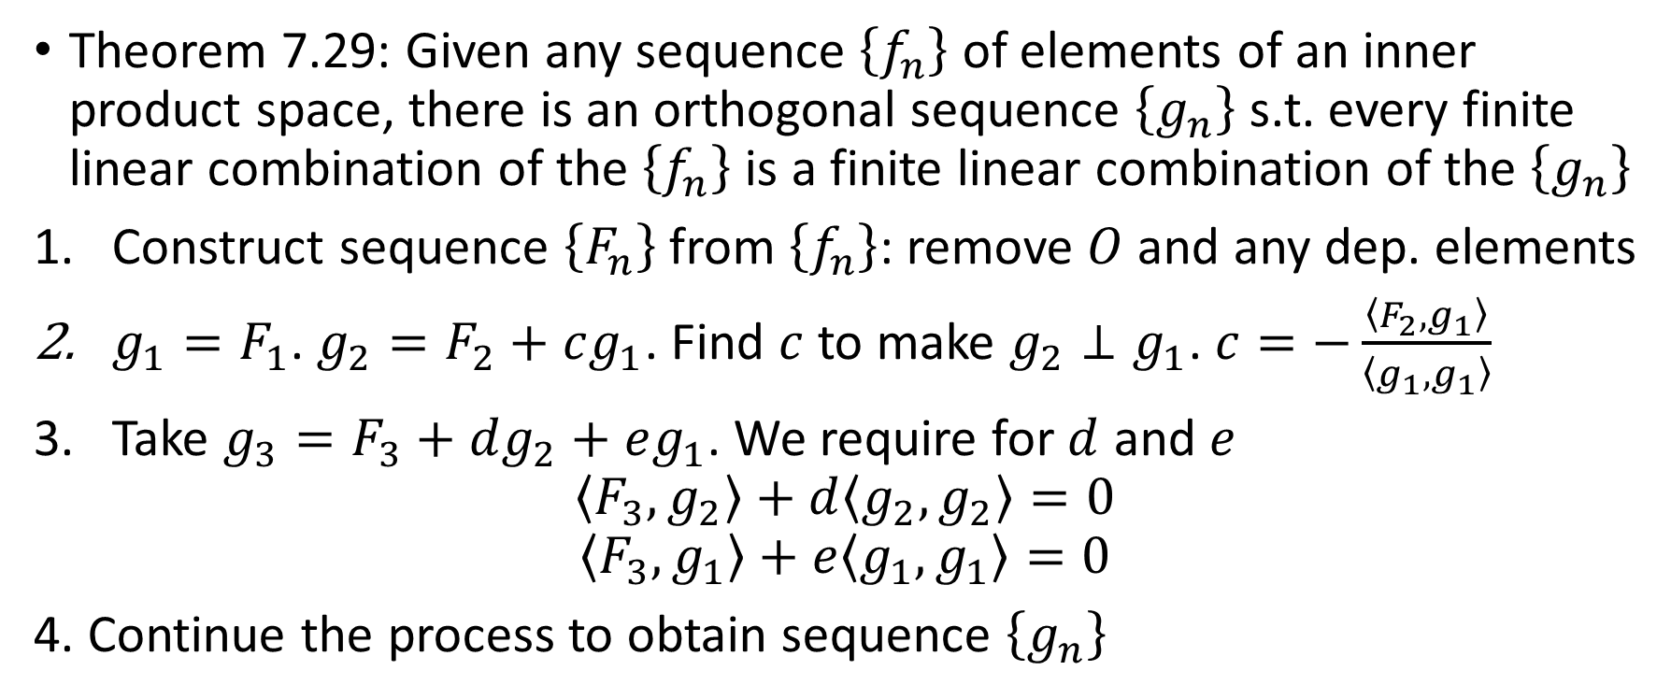
Gram-Schmidt Orthogonalization
Theorem 7.29: Given any sequence $\left\{f_{n}\right\}$ of elements of an inner product space, there is an orthogonal sequence $\left\{g_{n}\right\}$ s.t. every finite linear combination of the $\left\{f_{n}\right\}$ is a finite linear combination of the $\left\{g_{n}\right\}$
Construct sequence $\left\{F_{n}\right\}$ from $\left\{f_{n}\right\}$: remove $O$ and any dep. elements
$g_{1}=F_{1}$. $g_{2}=F_{2}+cg_{1}$. Find $c$ to make $g_{2}⊥g_{1}$. $c=−\frac{\left\langle F_{2},g_{1}\right\rangle }{\left\langle g_{1},g_{1}\right\rangle }$
Take $g_{3}=F_{3}+dg_{2}+eg_{1}$. We require for $d$ and $e$
$$\left\langle F_{3},g_{2}\right\rangle +d\left\langle g_{2},g_{2}\right\rangle =0$$
$$\left\langle F_{3},g_{1}\right\rangle +e\left\langle g_{1},g_{1}\right\rangle =0$$
4. Continue the process to obtain sequence $\left\{g_{n}\right\}$

Slide 7
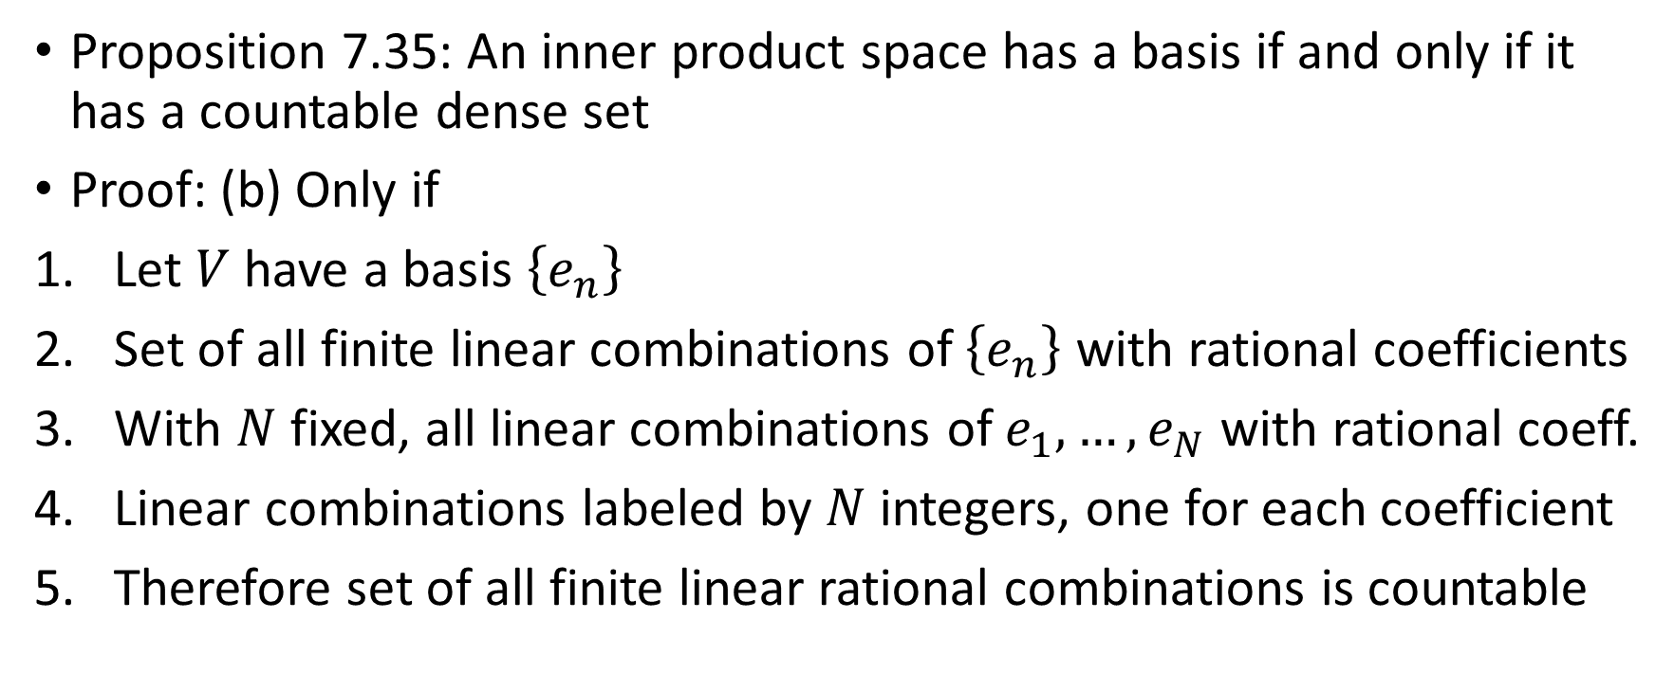
Existence of a Basis (contd.)
Proposition 7.35: An inner product space has a basis if and only if it has a countable dense set
Proof: (b) Only if
Let $V$ have a basis $\left\{e_{n}\right\}$
Set of all finite linear combinations of $\left\{e_{n}\right\}$ with rational coefficients
With $N$ fixed, all linear combinations of $e_{1},…,e_{N}$ with rational coeff.
Linear combinations labeled by $N$ integers, one for each coefficient
Therefore set of all finite linear rational combinations is countable

Slide 8
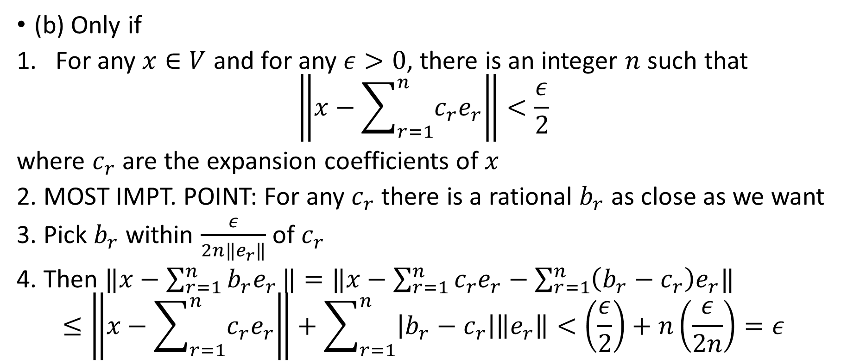
Existence of a Basis (contd.)
(b) Only if
For any $x∈V$ and for any $ε>0$, there is an integer $n$ such that
$$\left\|x−\sum_{r=1}^{n}{c_{r}e_{r}}\right\|<\frac{ε}{2}$$
where $c_{r}$ are the expansion coefficients of $x$
2. MOST IMPT. POINT: For any $c_{r}$ there is a rational $b_{r}$ as close as we want
3. Pick $b_{r}$ within $\frac{ε}{2n‖e_{r}‖}$ of $c_{r}$
4. Then $‖x−$ $\sum_{r=1}^{n}{b_{r}e_{r}}‖=‖x−\sum_{r=1}^{n}{c_{r}e_{r}}−\sum_{r=1}^{n}{\left(b_{r}−c_{r}\right)e_{r}‖}$
$$≤\left\|x−\sum_{r=1}^{n}{c_{r}e_{r}}\right\|+\sum_{r=1}^{n}{\left|b_{r}−c_{r}\right|\left\|e_{r}\right\|<\left(\frac{ε}{2}\right)+n\left(\frac{ε}{2n}\right)=ε}$$

Slide 9
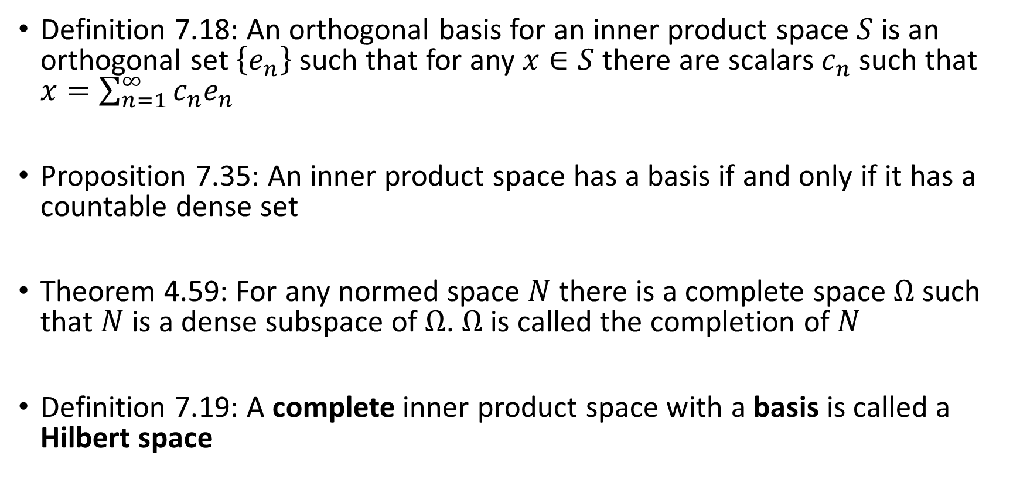
Hilbert Space
Definition 7.18: An orthogonal basis for an inner product space $S$ is an orthogonal set $\left\{e_{n}\right\}$ such that for any $x∈S$ there are scalars $c_{n}$ such that $x=\sum_{n=1}^{∞}{c_{n}e_{n}}$
Proposition 7.35: An inner product space has a basis if and only if it has a countable dense set
Theorem 4.59: For any normed space $N$ there is a complete space $Ω$ such that $N$ is a dense subspace of $Ω$. $Ω$ is called the completion of $N$
Definition 7.19: A complete inner product space with a basis is called a Hilbert space

Slide 10
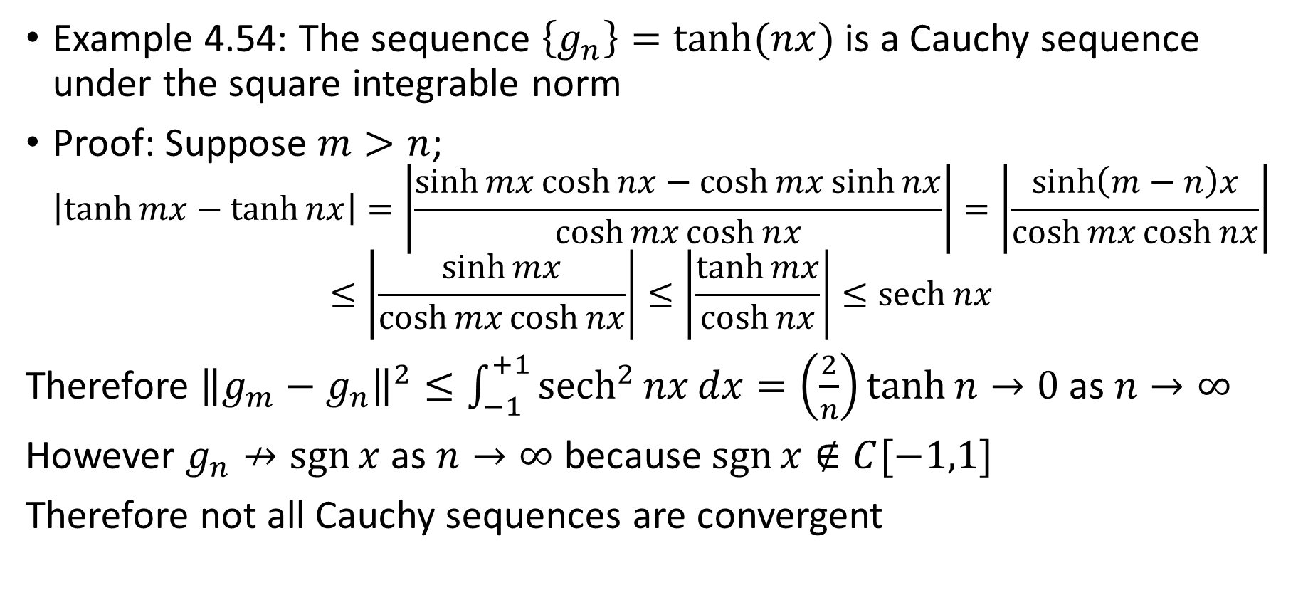
Not all Cauchy sequences are convergent
Example 4.54: The sequence $\left\{g_{n}\right\}=\tanh{(nx)}$ is a Cauchy sequence under the square integrable norm
Proof: Suppose $m>n$;
$$\left|\tanh{mx}−\tanh{nx}\right|=\left|\frac{\sinh{mx}\cosh{nx}−\cosh{mx}\sinh{nx}}{\cosh{mx}\cosh{nx}}\right|=\left|\frac{\sinh\left(m−n\right)x}{\cosh{mx}\cosh{nx}}\right|$$
$$≤\left|\frac{\sinh{mx}}{\cosh{mx}\cosh{nx}}\right|≤\left|\frac{\tanh{mx}}{\cosh{nx}}\right|≤\operatorname{sech}{nx}$$
Therefore ${\left\|g_{m}−g_{n}\right\|}^{2}≤\int_{−1}^{+1}{{sech}^{2}{nx}dx=\left(\frac{2}{n}\right)\tanh{n→0}}$ as $n→∞$
However $g_{n}↛\operatorname{sgn}{x}$ as $n→∞$ because $\operatorname{sgn}{x}∉C[−1,1]$
Therefore not all Cauchy sequences are convergent

